Slide 1
ISO/TC211 Ad Hoc Group on best practices for UML modelling
Sydney, Australia 2015-12-09

Slide 2
Agenda
Wed 2015-12-09 | Meeting of ad hoc group
11:00 | 1. Welcome and introduction | Convenor
 | 2. Roll call of members | Members
 | 3. Approval of agenda | Members
 | 4. Minutes of meeting for the Southampton meeting | Convenor
 | 5. Progress report | Convenor
 | 6. Discussion on registered issues (https://github.com/ISO-TC211/UML-Best-Practices/issues) | Members
 | 7. Discussion on issues to add | Members
 | 8. Revised action plan for the group | Convenor, Members
12:30 | Close – with possibility to continue discussions in the HMMG Meeting

Slide 3
GitHub https://github.com/ISO-TC211/UML-Best-Practices
https://github.com/ISO-TC211/UML-Best-Practices
For reference documents, scripts, illustrations etc.
https://github.com/ISO-TC211/UML-Best-Practices/wiki
Wiki for UML Best practices
https://github.com/ISO-TC211/UML-Best-Practices/issues
For issue tracking

Slide 4
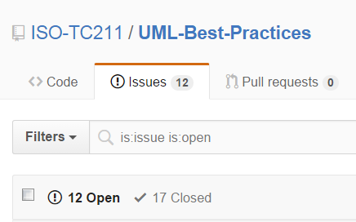
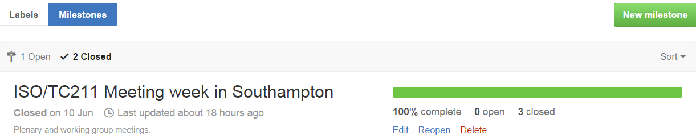

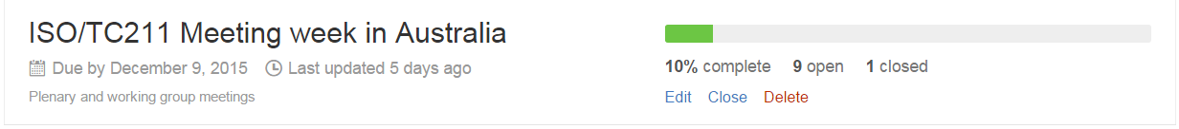
Progress report

Slide 5
Status
Much work done on diagram design
Few issues open
Much work done on modelling
Several issues open
Much work done on documentation
Much work done on scripts and tools
Scripts in VBScript, JScript, searches (XML)
Several contributors have scripts that have been uploaded
Much work done on basic UML
Relevant requirements and recomendations
Levels of abstraction
Few issues open
Much left to do on implementation issues
Few issues open

Slide 6
Issues for discussion
Versions of models
Morten Borrebæk
Automated documentation
Roland Grillmayer
Modelling relationships
Geometry constrains
Voidable & multiplicity
Anthony – IHO
Backwards compatibility

Slide 7
New UML BP issues
Scripts
Naming conventions for scripts.
Sample scripts in models, to see workflows and how they influence with the models.
Script for multilingual names
Links to GOM Scripts
Scripts for definition import/export
Group of scripts for model validation
References to the XML and GOM Wikis
Composition vs association
Geometry constraints
Voidable
Versions
Adjust to fit for national models too.
Need a status “withdrawn“, “replaced” or similar?
Package structure
Illustrating changes between versions

Slide 8
Issues for discussion
https://github.com/ISO-TC211/UML-Best-Practices/issues

Slide 9

Revised action plan
Options:
Continue as AHG
Merge into HMMG
Create new permanent group, associated to HMMG
No matter what happens:
Continue the work
Wiki to be moved to official ISO/TC211 Wiki in the future

